Slide 1

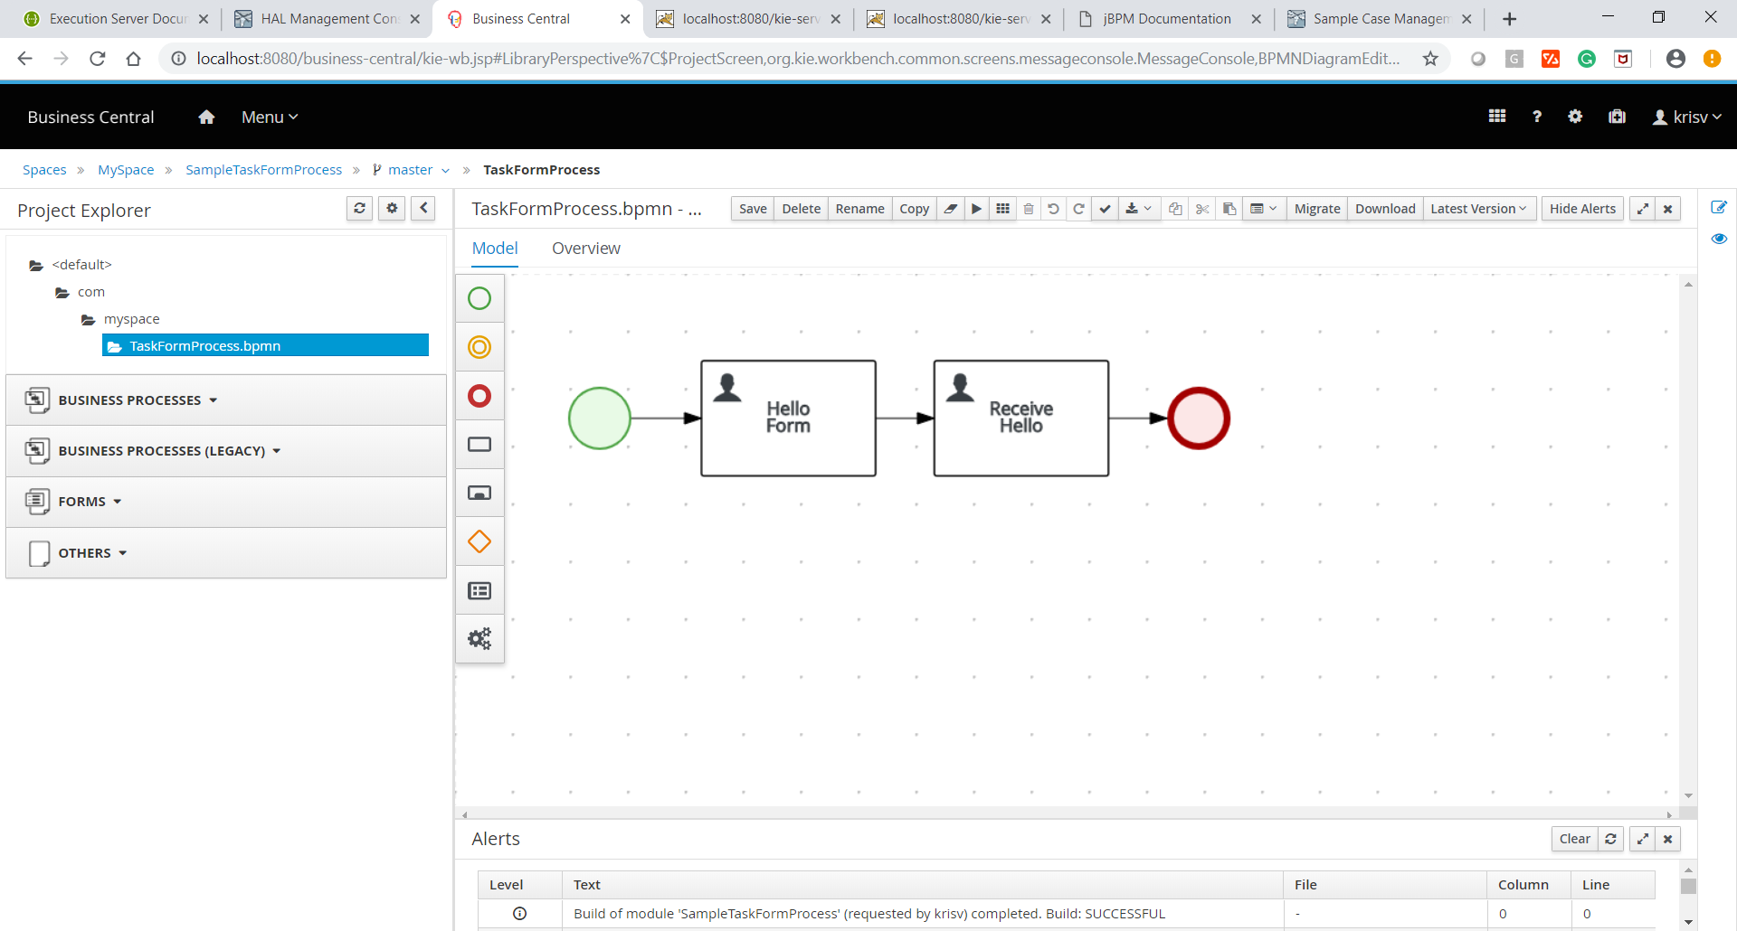
Designer
Notes:
Working with the jBPM console

Slide 2


Agenda
We are covering below topics
Generation of process and task forms
View processes as PDF and PNG
Viewing process BPMN2 source
Visual Process Validation
Generating code to share process image, PDF & embedded process editor
Importing existing BPMN2 processes
Viewing Process Information
Support for Domain-specific service nodes
Configuring Designer
Embedding designer in your own application
Integration with the jBPM Service Repository
Requirements

Slide 3
Generation of process and Task Forms

Slide 4
View processes as PDF and PNG

Slide 5
Viewing process BPMN2 source

Slide 6
Visual Process Validation

Slide 7
Generating code to share process image, PDF & embedded process editor

Slide 8
Importing existing BPMN2 processes

Slide 9
Viewing Process Information

Slide 10
Support for Domain-specific service nodes

Slide 11
Configuring Designer

Slide 12
Embedding designer in your own application

Slide 13
Integration with the jBPM Service Repository

Slide 14
Requirements

Slide 15

Quiz
Desginer

Slide 16
Quiz
_____ allows you to set both process and shape properties.
Toolbar
Object Library Panel
Properties Panel
View Tabs

Slide 17

Answers
_____ allows you to set both process and shape properties.
Toolbar
Object Library Panel
Properties Panel
View Tabs

Slide 18
Quiz
Designer is a graphical web-based BPMN2 editor
True
False

Slide 19
Answers
Designer is a graphical web-based BPMN2 editor
True
False

Slide 20
Conclusion

Slide 21
Summary
In this session, you have learnt:
Generation of process and task forms
View processes as PDF and PNG
Viewing process BPMN2 source
Visual Process Validation
Generating code to share process image, PDF & embedded process editor
Importing existing BPMN2 processes
Viewing Process Information
Support for Domain-specific service nodes
Configuring Designer
Embedding designer in your own application
Integration with the jBPM Service Repository
Requirements

Slide 22
Hands-On
Practical

Slide 23
Hands-On 1
Create jBPM Project using designer and see all the Properties of Designer.
Connect to Service repository and custom WorkItem handler.

Slide 24

India : +91-7847955955
US : 1-800-216-8930 (TOLL FREE)
support@intellipaat.com
24X7 Chat with our Course Advisor
Notes:
Thank you!

